Slide 1

Developing Cross Platform Mobile Applications using Cordova
Avinash Chandra, FullStack Developer, IBM

Slide 2
Agenda
Introduction to Mobile Apps Development using Cordova
Market need
Introduction to Cordova
Cordova application architecture
Device API support on various platform
When to use Cordova
Who are using Cordova
Deep Dive in Cordova App Development
Working demo
When Not to use Cordova ?
When to go for Native application development

Slide 3
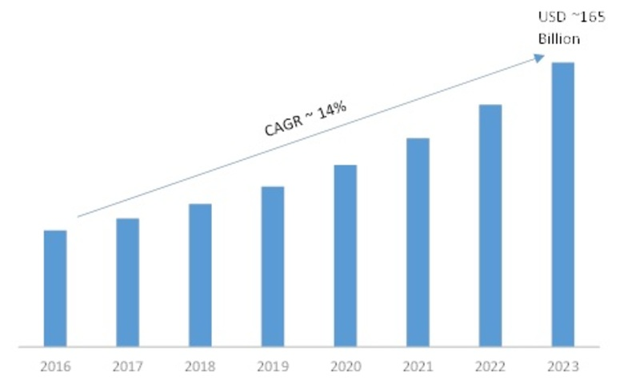
Growing market of Mobile Apps
Source: Market Research Future

Slide 4
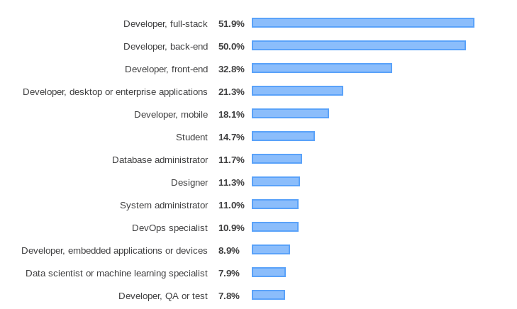
Developers exist on the planet
Source: StackOverlow Developer Survey 2019

Slide 5
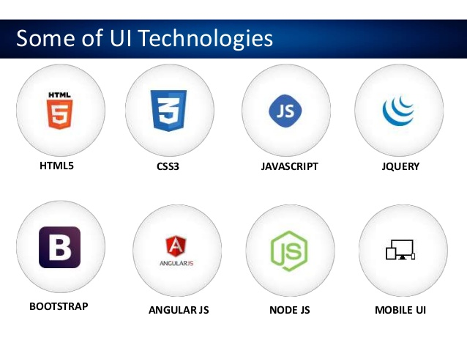
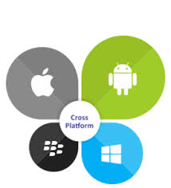

Using UI Development Technologies with Cordova

Slide 6
Introduction to Cordova
Apache Cordova is an open-source mobile development framework. It allows you to use standard web technologies - HTML5, CSS3, and JavaScript for cross-platform development.
Cordova wraps your HTML/JavaScript app into a native container which can access the device functions of several platforms. These functions are exposed via a unified JavaScript API, allowing you to easily write one set of code to target nearly every phone or tablet on the market today and publish to their app stores.

Slide 7
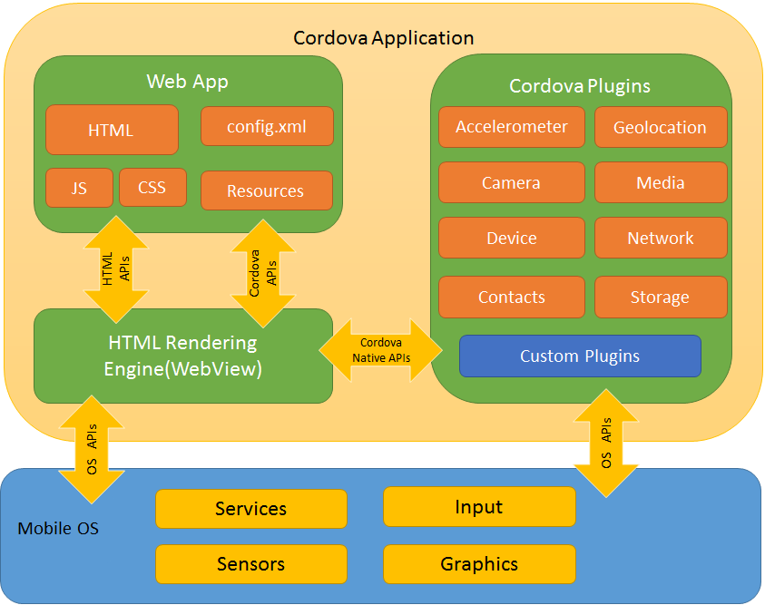
Cordova Application Architecture

Slide 8
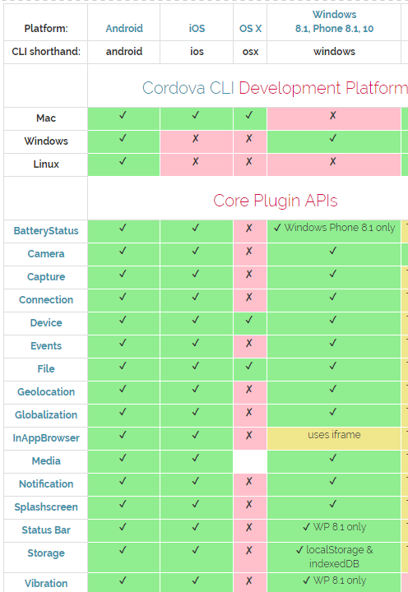
Device API support on various platform

Slide 9
When to use Cordova
Use Apache Cordova if you are:
Looking to develop a faster prototype with immediate changes as you are not sure about the requirement.
a mobile developer and want to extend an application across more than one platform, without having to re-implement it with each platform's language and tool set.
a web developer and want to deploy a web app that's packaged for distribution in various app store portals.
a mobile developer interested in mixing native application components with a WebView that can access device-level APIs, or if you want to develop a plugin interface between native and WebView components.

Slide 10
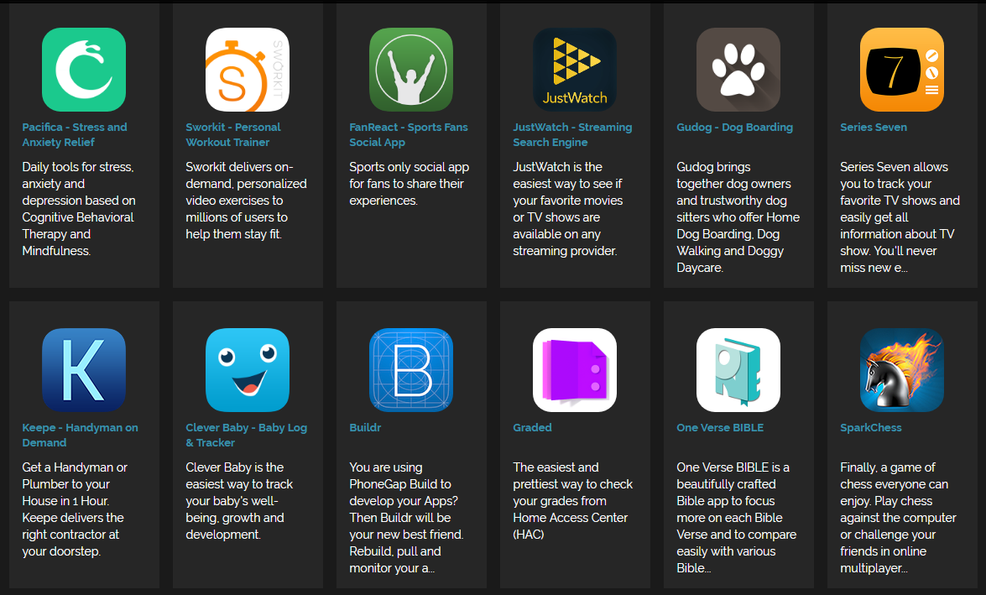
Who are using Cordova

Slide 11
Deep Dive in Cordova App Development

Slide 12

Working Demo…

Slide 13
Type of Storage
Web Storage : It is basically a single persistent object called localStorage.
Web SQL : is a structured database with all the functionality - and complexity - of a typical SQL-powered relational database
Indexed DB : An Indexed Database is a collection of "object stores" which you can just drop objects into.
File API : To store large files and binary content

Slide 14
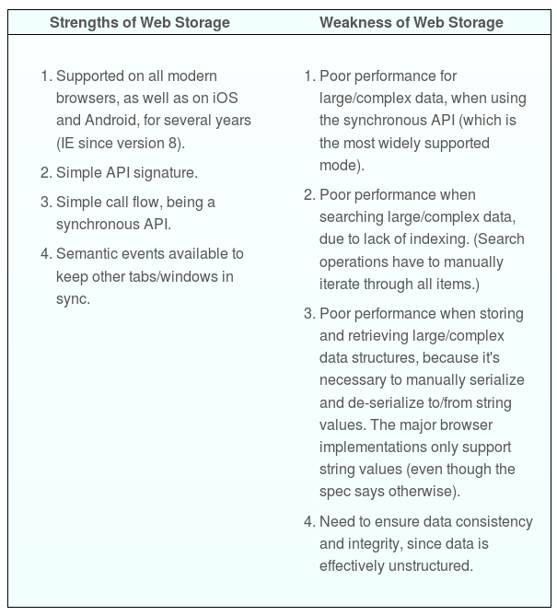
WebStorage

Slide 15
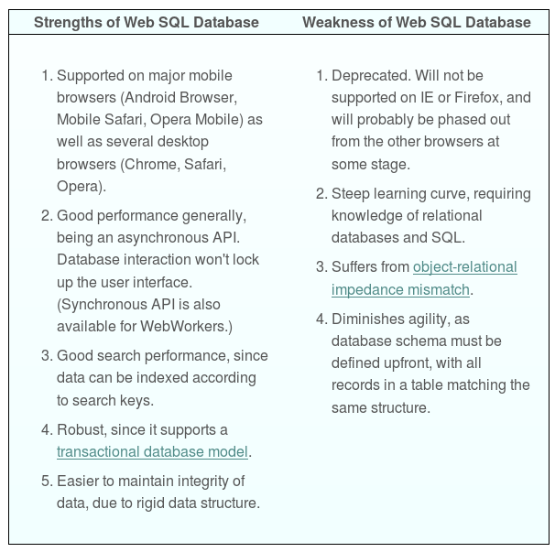
Web SQL

Slide 16
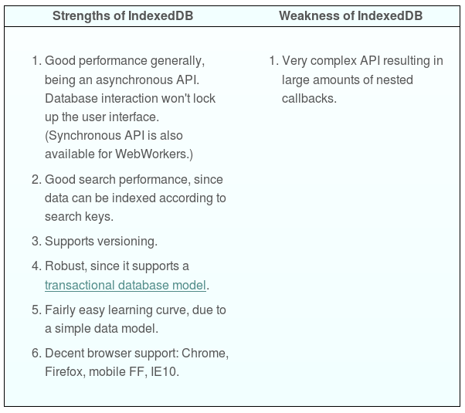
Indexed DB

Slide 17
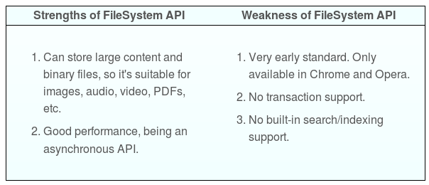
File API

Slide 18
When Not to use Cordova ?

Slide 19
When to go for Native application development
Apache Cordova will not suit if you are:
Looking to develop an app that need Native support like using Android NDK (machine dependent development).
less facilities in javascript for modularization of large-scale applications than Objective-C or Java
JavaScript is not multi-threaded and hence doesn’t support background processing.
Apps that use advanced graphics which can only be accessed using third-party libraries like Unity 3D, OpenGL are best done natively.

Slide 20

Thank you
avinash.chandra@in.ibm.com

